Slide 1
H o p e
Why God…?
A Moral Cause
Hurting
For The
A Study in 1 Peter
The Essentials of Apologetics
www.confidentchristians.org

Slide 2
Introduction
Does true right and wrong exist or is everything relative?

Slide 3
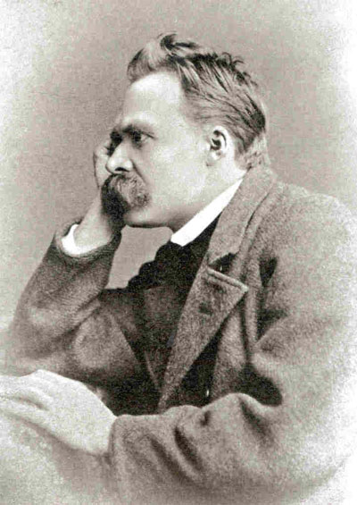
“You have your way, I have my way. As for the right way, it does not exist.”
– Frederick Nietzsche
Notes:
http://goo.gl/SGBvg

Slide 4
Sometimes or Always Wrong?
Torturing babies for fun.
The Indian practice of widow burning (sati).
Priests sexually abusing children and church authorities covering it up.
Rape.
Murder of innocent people.

Slide 5
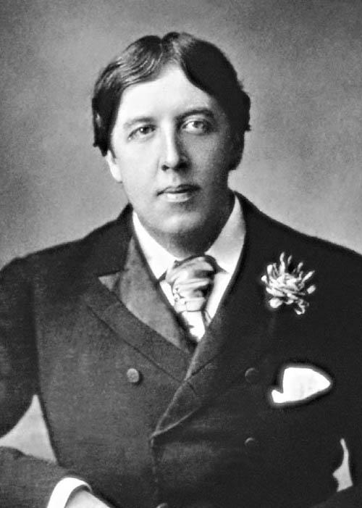
“Nothing succeeds like excess … nothing is good or bad, only charming or dull.”
– Oscar Wilde

Slide 6
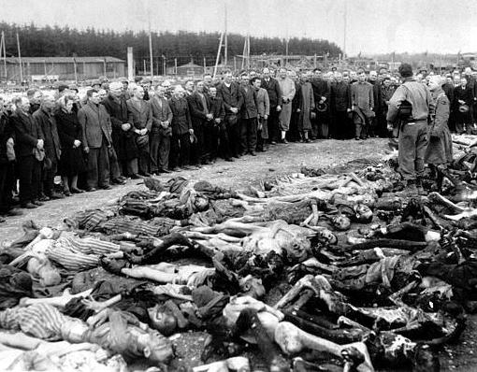
Is This Charming or Dull … or Wrong?

Slide 7
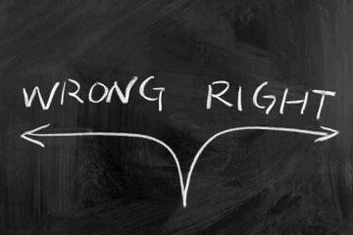
Right and Wrong
Few deny that some acts are always morally wrong.
This equates to there being objective moral values and duties in life.

Slide 8
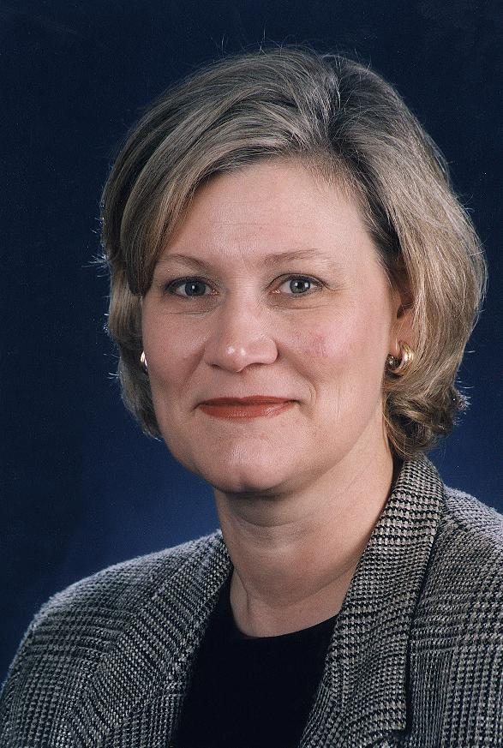
“Any argument against the objective reality of moral values will be based on premises that are less obvious than the existence of objective moral values themselves.”
– Louise Antony
Atheist Philosopher

Slide 9
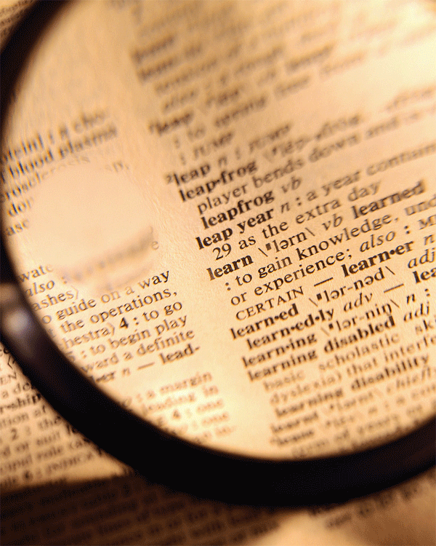
Defining Terms
Objective: independent of opinion (e.g. if 51% of the population said rape was right, it would still be wrong).
Values: whether something is good or bad; a description of worth.
Duties: indicates an oughtness of action; whether an act is obligatory.

Slide 10
Key Ingredients for Objective Moral Values/Duties
A Standard – provides a measure of good/bad, right/wrong.
An Authority – someone/thing that has the right to impose the standard and enforce adherence.

Slide 11
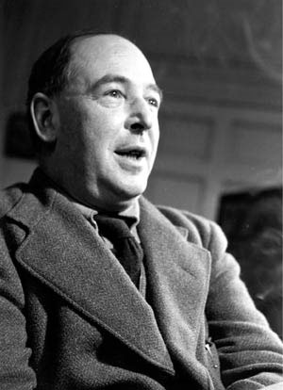
“A man does not call a line crooked unless he has some idea of a straight line.”
– C. S. Lewis
Notes:
http://goo.gl/SGBvg

Slide 12
A Key Distinction
There is a distinction between the source of objective moral values and duties and how we come to know them.
The first is an ontological (source/origin) question.
The second is an epistemological (knowledge) question.

Slide 13
The Possible Sources of Objective Moral Values/Duties
The universe
Society/culture
The individual
A transcendent Creator

Slide 14
Examining the Options
What is the Source of Objective Moral Values and Duties?

Slide 15
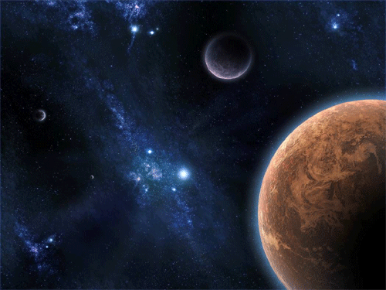
From the Universe?
“A man said to the Universe,
Sir, I exist!
Nevertheless, replied the Universe,
That fact has not created in me
The slightest feeling of obligation.”
- Stephen Crane

Slide 16
From the Universe?
From a cause/effect standpoint, an effect must represent its cause in essence/nature.
How can an amoral, impersonal, meaningless and purposeless universe accidentally create personal moral beings who are obsessed with meaning and purpose?

Slide 17
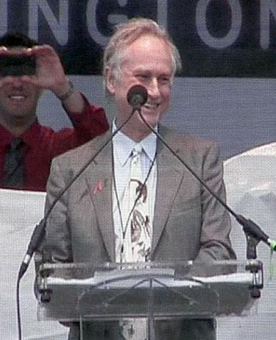
“Humans have always wondered about the meaning of life...life has no higher purpose than to perpetuate the survival of DNA...life has no design, no purpose, no evil and no good, nothing but blind pitiless indifference”
– Richard Dawkins

Slide 18
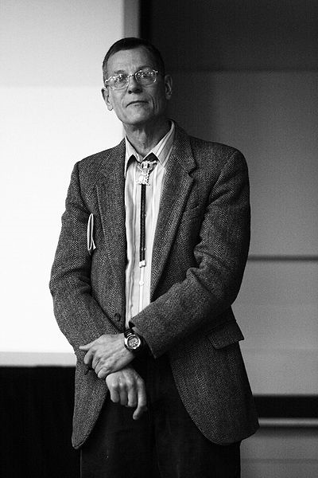
“When Darwin deduced the theory of natural selection to explain the adaptations in which he had previously seen the handiwork of God, he knew that he was committing cultural murder. He understood immediately that if natural selection explained adaptations, and evolution by descent were true, then the argument from design was dead and all that went with it, namely the existence of a personal god, free will, life after death, immutable moral laws, and ultimate meaning in life.”
– William Provine

Slide 19
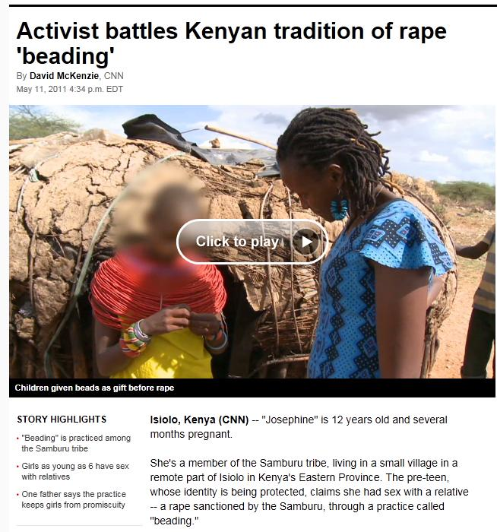
From Culture?
In Kenya, the practice of “beading” is carried out. A close family relative of a young girl places a strand of beads around the young girl’s neck.
This effectively is a temporary engagement and the relative can now have sexual relations with her.
Some girls are “beaded” when they are six years old.
Many young girls get pregnant and either have abortions or kill their babies at birth.
When they reach adulthood, the girls will marry outside of their village, but taboo dictates the girls will never be able to marry if they keep their babies resulting from beading.
Is beading right or wrong…?
Notes:
http://www.cnn.com/2011/WORLD/africa/05/11/kenya.children.beading/index.html?hpt=P1&iref=NS1

Slide 20
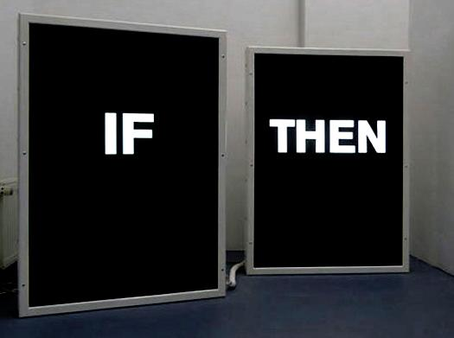
If Culture is the Source of Objective Morals/Duties Then…
Widow burning can be morally acceptable…
Cannibalism can be morally acceptable…
Murder can be morally acceptable…
Unforgiveness can be morally acceptable…
Rape can be morally acceptable…
Gratuitously torturing innocent babies can be morally acceptable…

Slide 21
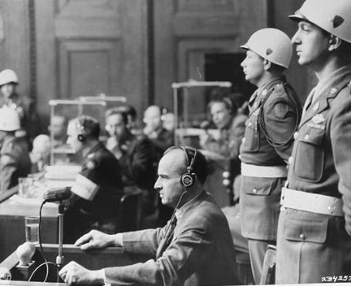
From Culture?
During the trials at Nuremberg, the Nazi defense attorneys argued that Hitler’s soldiers who were on trial were only following the orders of their society and should therefore not be held accountable.
A judge countered that argument with the question, “But sir, is there not a law above our laws?”
We need an ultimate authority to appeal to in matters that transcend history and culture/society.

Slide 22
From Culture?
What/who is mankind morally obligated to? Real moral obligation exists, but to whom?
Consider the issue of the “Reformer’s Dilemma”. How can a culture ever be positively influenced from the outside if the culture is the determiner of good and evil?

Slide 23
From the Individual?
How do you decide between differing moral opinions if each individual is the ultimate decision maker of what is good and bad?
How does the statement “For me, rape is wrong, but it might be OK to you” sound?
With individuals, everything boils down to emotion and emotive responses to morals without moral global absolutes.

Slide 24
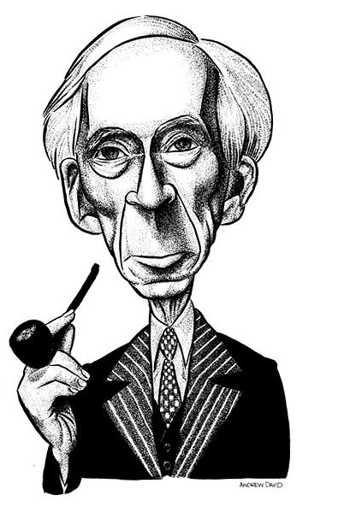
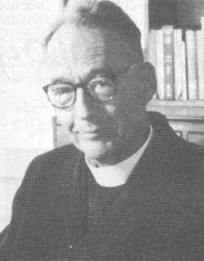
From the Individual?
In his debate with the atheist Bertrand Russell, the Jesuit and philosopher Frederick Copleston looked at Russell and asked, “Lord Russell, do you believe in good and bad?” Russell replied, “Yes”.
Copleston continued, “How do you differentiate between good and bad?” Russell replied, “The same way I differentiate between blue and green or yellow and green.” Copleston then said, “Wait a minute, you differentiate between yellow and green by seeing don’t you?” Russell said, “Yes”.
So Copleston challenged him by asking, “How do you differentiate between good and bad?” Russell replied, “I differentiate on those matters on the basis of my feelings, what else?”

Slide 25
People May Espouse Relativism But They Demand Absolutes
Watching how people react to being ‘wronged’ proves they want and recognize absolute morality.
Steal from a relativist; let them be the victim of false advertising; watch how they respond when their spouse is relatively faithful to them vs. absolutely faithful, and the reaction showcases the recognition of absolute morality.

Slide 26
From the Individual?
“Science cannot tell you if it’s right or wrong for you to eat your own baby’s clone, but it can tell you that’s what you are actually doing. Then you can decide for yourself if you think it’s right or wrong.”
– Richard Dawkins

Slide 27
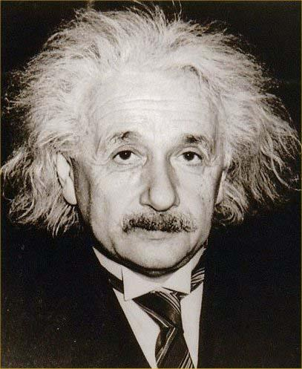
What About Science?
“You are right in speaking of the moral foundations of science, but you cannot turn round and speak of the scientific foundations of morality.”
– Albert Einstein
Notes:
http://goo.gl/SGBvg

Slide 28
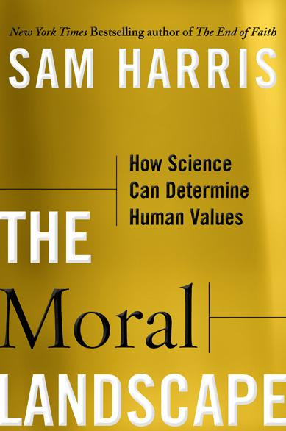
What About Science?
“The moral landscape is a space of real and potential outcomes whose peaks correspond to heights of potential well being and whose valleys represent the deepest possible suffering. . . . Questions about values are really questions about the well being of conscious creatures.”
– Sam Harris

Slide 29
Why Harris’ Attempt Fails
Harris redefines good to be “the flourishing/well-being of conscious creatures”.
Harris admits in his book that it is possible that the peak of the “moral landscape” could be occupied by flourishing rapists, murderers, and thieves.
So he admits it’s possible that goodness and creaturely well-being are not identical.
Therefore, Harris’ moral theory collapses.

Slide 30
Where Does This Leave Us?
The universe
Society/culture
The individual
A transcendent Creator

Slide 31
The Moral Argument for God
Why a Transcendent Creator is Needed for Objective Moral Values and Duties.

Slide 32
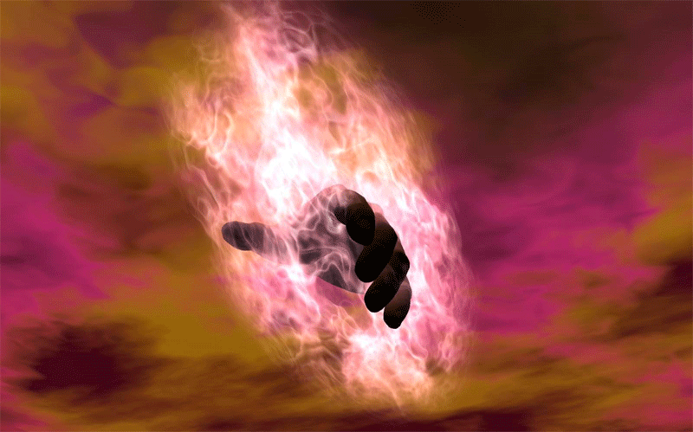
One Moral Argument for God
Laws imply a Law Giver.
There is an objective Moral Law.
Therefore, there is a Moral Law Giver.

Slide 33
Another Moral Argument for God
If God does not exist, objective moral values and duties do not exist.
Objective moral values and duties exist.
Therefore, God exists.

Slide 34
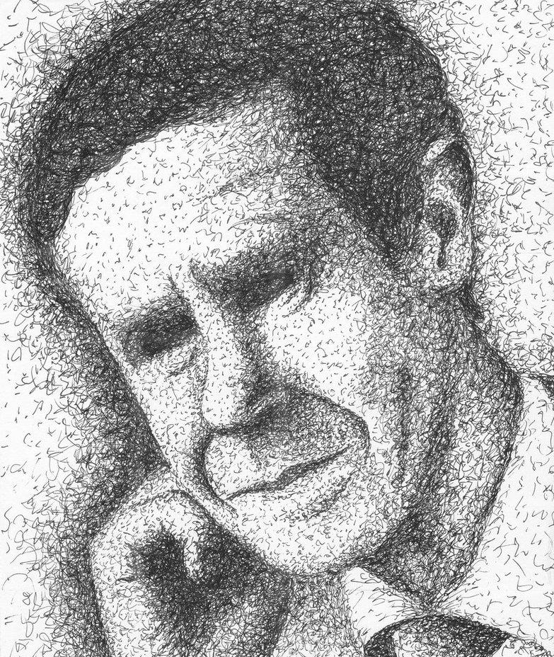
“We might well argue that objective intrinsically prescriptive features supervenient upon natural ones constitute so odd a cluster of qualities and relations that they are unlikely to have arisen in the ordinary course of events without an all-powerful God to create them.”
– J. L Mackie
Atheist Philosopher

Slide 35
The Atheist Dilemma
If there’s such a thing as evil, you must assume there’s such a thing as good.
If you assume there’s such a thing as good, you assume there’s such a thing as an absolute and unchanging moral law on the basis of which to differentiate between good and evil.
If you assume there’s such a thing as an absolute moral law, you must posit an absolute moral law giver, but that would be God – the one whom the atheist is trying to disprove.
So now rewind: if there’s not a moral law giver, there’s no moral law. If there’s no moral law, there’s no good. If there’s no good, there’s no evil.

Slide 36
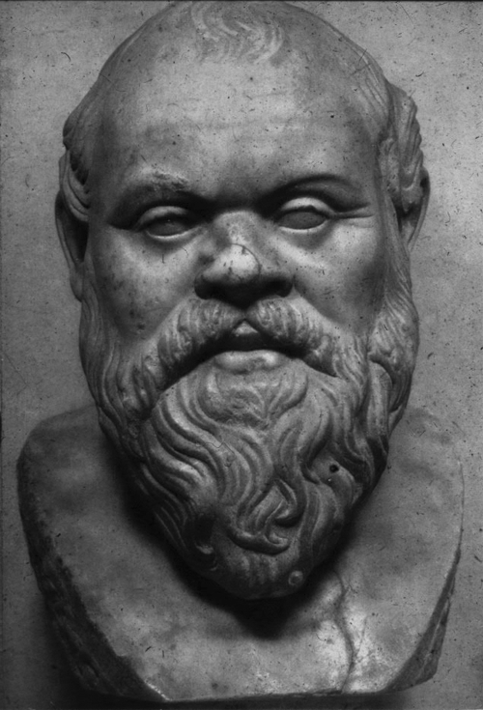
What About the Euthyphro Dilemma?
Is something good because God approves it, or does God approve something because it’s good?
The first makes God arbitrary.
The second makes ‘good’ independent of God.

Slide 37
Solving the Euthyphro Dilemma
God is the greatest possible being.
God’s nature is what grounds absolute moral right/wrong.
God has no obligations to anything outside of Himself.
He simply acts and what he naturally does is good because it comes from His nature/essence.

Slide 38
Conclusions
Final Thoughts

Slide 39
The Source of Objective Moral Values and Duties
God provides the only objective standard for moral values.
God provides the only transcendent authority for enforcing the “oughtness” of moral duties.

Slide 40
For More Information/Presentations
www.powerpointapologist.org
www.confidentchristians.org

Slide 41
For More Apologetics Resources
www.apologetics315.com

Slide 42
H o p e
Why God…?
A Moral Cause
Hurting
For The
A Study in 1 Peter
The Essentials of Apologetics
www.confidentchristians.org

